Slide 1
Welcome to Reception
Northburn Primary School

Slide 2
When we look at a building, we only see the structure from the ground level up. We do not see the foundations, the important parts that enable the building to function. This essential part of the building is hidden from view – but if the foundations are NOT there or are badly built, the building itself will crack and collapse. So it is with the education in early childhood. The early years are not a ‘holding period’ until the really important education begins. Early years lays the foundations for all future learning. (Max de Boo – ASE)

Slide 3
Welcome! We can’t wait to meet you all. As you can understand, circumstances are different to what they would normally be for the children starting in Reception. Currently, we do not have a start date or information about the procedures for the new school year. We will however, keep you updated as soon as we have any further information or government guidance.

Slide 4
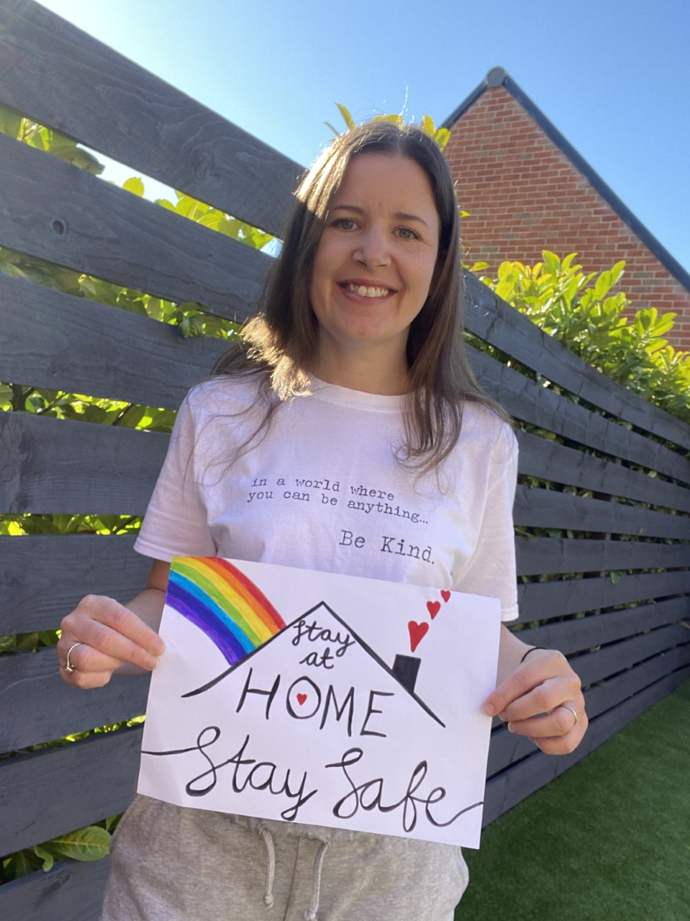
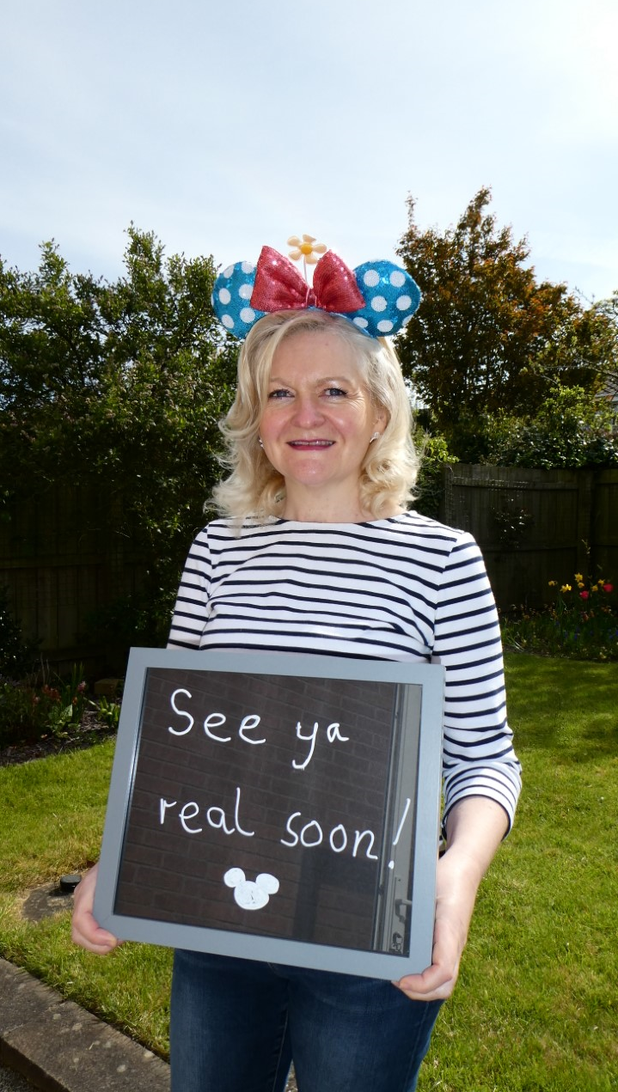
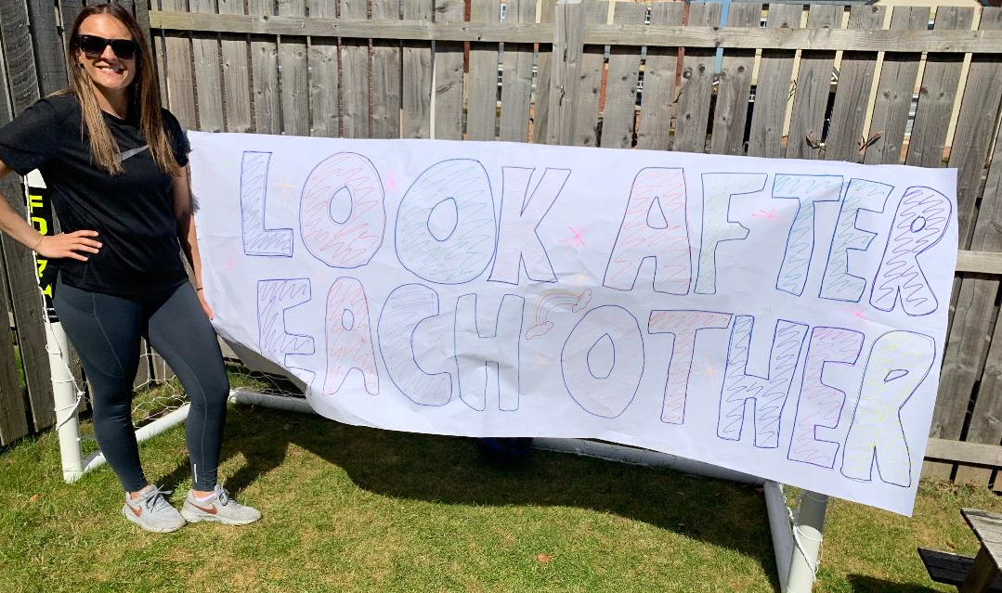
Meet the Team!
Mrs Boxshall – Class 3
Mrs Palmer – Class 2
Mrs Coull – Class 2

Slide 5
Our School Day: Starter activity – handwriting, number formation, GoNoodle, fine motor activities Read Write Inc Phonics Session Snack Time & Break Maths and English session with independent group work activities Lunch Topic Activities – (understanding the world, art, outdoor learning, music, PE, PSHE)
Our School Day

Slide 6
The EYFS Curriculum is organised into 7 areas of learning. The three prime areas are: Language and Communication Personal, social and emotional development Physical Development We also focus on the other areas including: Literacy Numeracy Understanding of the World Expressive Arts and Design
Statutory Framework for the Early Years Foundation Stage

Slide 7
Reading Folder (please keep all flashcards and reading books in there each day) Water bottle (clearly named) PE Kit – (see uniform policy but they do not require any sandshoes for the first term, please name all items) Suitable outdoor clothing – we do go out in any weather so please make sure your child is suitably prepared Please name ALL of your children’s items, it is really difficult to keep track of belongings if they are not named.
What do the children need for school each day?

Slide 8
Initially, children can change from hot school dinners to packed lunches. Children are initially served the same hot meal, this is to encourage the children to try new things. After the first half term, we ask that they stick to one type of meal or the other. Changes must be arranged at the school office. All Reception children can have a hot school dinner for free
School Dinners

Slide 9
Parents are children’s first and foremost teachers. Parents and family are the primary influence on a child’s development. Anyone who takes on a parenting role will strongly affect language development, emotional growth, social skills and personality. High quality early childhood settings engage parents as partners in early education. Effective settings maintain strong communication with parents, learn more about the child from the family and work together with the family to meet each child’s needs.
Home School Links

Slide 10
The children will be given different things to complete at home. Sydney Snail’s Learning Trails – Each month we will send home a challenge to complete, these will cover different areas of the curriculum Reading Activities – sound cards, key words, reading books Number Formation
Reception Home School Links

Slide 11
The children will be given a blue book (reading record) a few weeks after starting Reception. This will contain lots of information including sounds to learn and information about the school challenge award. The School Challenge Award is a set of activities the children will be able to complete both in and out of school. This will help the children develop lots of skills including resilience and team work. We will introduce these to the children throughout the year and share more information about how they can complete them.
Reading Book/ Challenge Award

Slide 12
In Reception we spend a lot of time outdoors. Mrs Palmer and Mrs Coull are currently training to be qualified Forest School Practitioners. This means the children will be involved in lots of outdoor activities, building skills and learning about nature. The children will come home muddy but with a smile on their face! Please provide a named pair of wellies for the children to leave at school, we go outside in all weathers and wellies will allow the children to fully involve themselves. A suitable coat is essential too.
Forest School and Welly Wednesday

Slide 13
If your child hurts themselves at school they will be helped by a trained member of staff. For small cuts and grazes that just require cleaning we will not issue a first aid slip. For injuries that require more help we will send a first aid slip home to explain what has happened and the treatment required.
First Aid

Slide 14
We will share some of your child’s learning experiences on Tapestry and we really encourage you to comment and like the posts. Please add your own observations, days out and learning experiences from home. We love to see what the children get up to outside of school.
Tapestry

Slide 15
Encourage your child to use a knife and fork at home to cut and eat their food Children will be required to undress/dress for PE independently – please practise this regularly Coats – put on and zip up independently Start to take responsibly for their own belongings – add a keyring to their reading folder to help them identify it
How can I prepare my child for school?

Slide 16
On the first day please encourage your child to line up (social distance if in place) behind the chairs on the yard with the class numbers displayed. Unfortunately due to current guidelines parents will not be able to come in to the school building. Staff will be on hand to support your children, a quick goodbye is recommended and we will be able to settle the children quickly. Please ensure your child has: Wellies (Named) Suitable outdoor coat Reading folder with a keyring to help the children identify it PE Kit – all items named, PE kits will remain in school until half term Any prescribed medication (inhaler etc and completed medical forms)
Final Checklist!

