Slide 1
Welcome to Nursery
Northburn Primary School

Slide 2
When we look at a building, we only see the structure from the ground level up. We do not see the foundations, the important parts that enable the building to function. This essential part of the building is hidden from view – but if the foundations are NOT there or are badly built, the building itself will crack and collapse. So it is with the education in early childhood. The early years are not a ‘holding period’ until the really important education begins. Early years lays the foundations for all future learning. (Max de Boo – ASE)

Slide 3
Welcome! We can’t wait to meet you all. As you can understand, circumstances are different to what they would normally be for the children starting in Nursery. Currently, we do not have a start date or information about the procedures for the new school year. We will however, keep you updated as soon as we have any further information or government guidance.

Slide 4
Starter activity – Wake and Shake followed by key group focus. Continuous provision in and outdoors. (Activities are a combination of adult and child led). Snack time Phase one Phonics Session Story/song time. Our school day is fun. We focus on the children interests within the seven areas of learning.
Our Nursery Day

Slide 5
The EYFS Curriculum is organised into 7 areas of learning. The three prime areas are: Language and Communication Personal, social and emotional development Physical Development We also focus on the other areas including: Literacy Numeracy Understanding of the World Expressive Arts and Design
Statutory Framework for the Early Years Foundation Stage

Slide 6
Small bag with a change of clothes Suitable outdoor clothing including wellies which can stay at school – we do go out in any weather so please make sure your child is suitably prepared Please name ALL of your children’s items, it is really difficult to keep track of belongings if they are not named. Drinks and snacks will be provided.
What do the children need for school each day?

Slide 7
Initially, Children can change from hot school dinners to packed lunches. Children are initially served the same hot meal, this is to encourage the children to try new things. After the first half term, we ask that they stick to one type of meal or the other. Changes must be arranged at the school office.
School Dinners (Children attending 30 hours only)

Slide 8
Parents are children’s first and foremost teachers. Parents and family are the primary influence on a child’s development. Anyone who takes on a parenting role will strongly affect language development, emotional growth, social skills and personality. High quality early childhood settings engage parents as partners in early education. Effective settings maintain strong communication with parents, learn more about the child from the family and work together with the family to meet each child’s needs.
Nursery Home Links

Slide 9
The children will be given different things to complete at home. Tapestry Challenge – We will send home a challenge to complete, these will cover different areas of the curriculum. Reading Activities – We encourage children to gain a love of stories.
Nursery Home Links

Slide 10
We will share some of your child’s learning experiences on Tapestry and we really encourage you to comment and like the posts. Please add your own observations, days out and learning experiences from home. We love to see what the children get up to outside of school.
Tapestry

Slide 11
Encourage your child to use a knife and fork at home to cut and eat their food Coats/ shoes – put on coat and fasten own shoes (Velcro shoes support the children's independence. Start to take responsibly for their own belongings – add a keyring to their reading folder to help them identify it
How can I prepare my child for school?

Slide 12
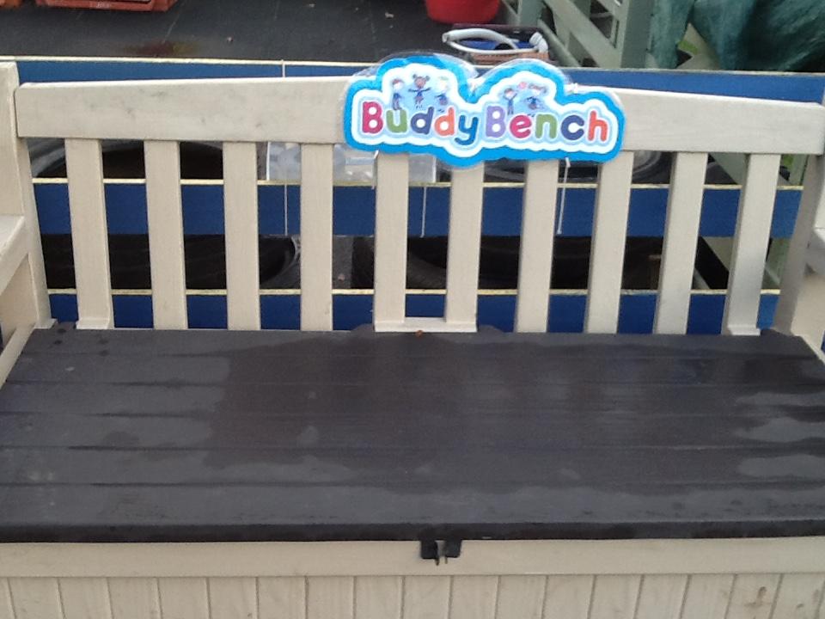
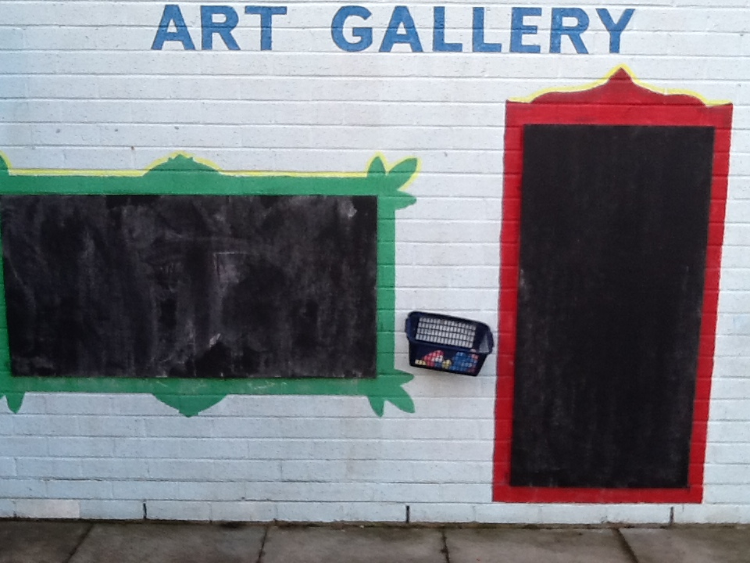
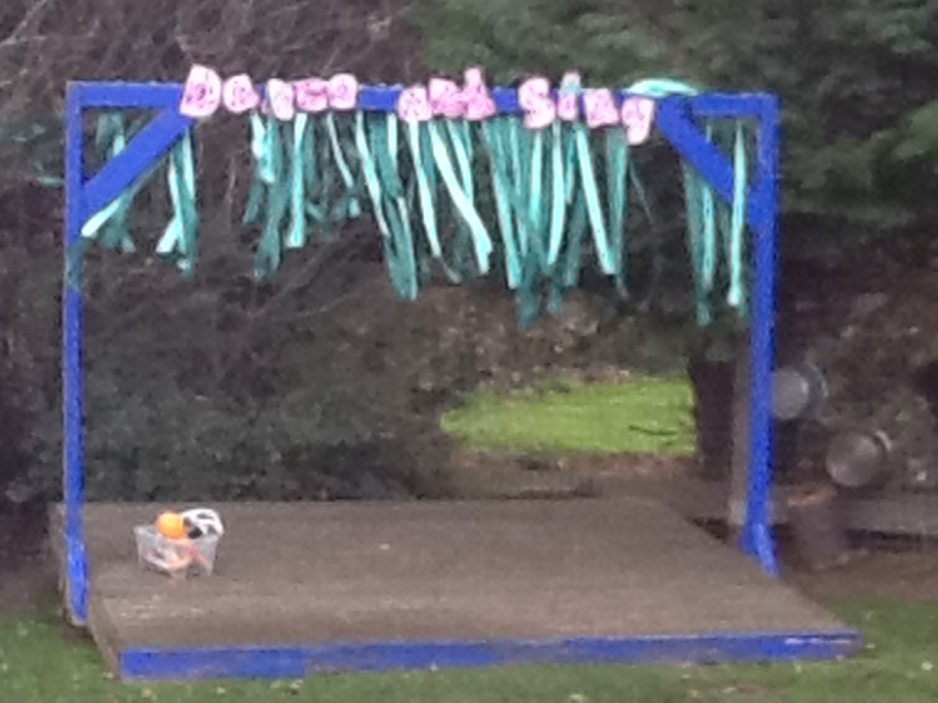
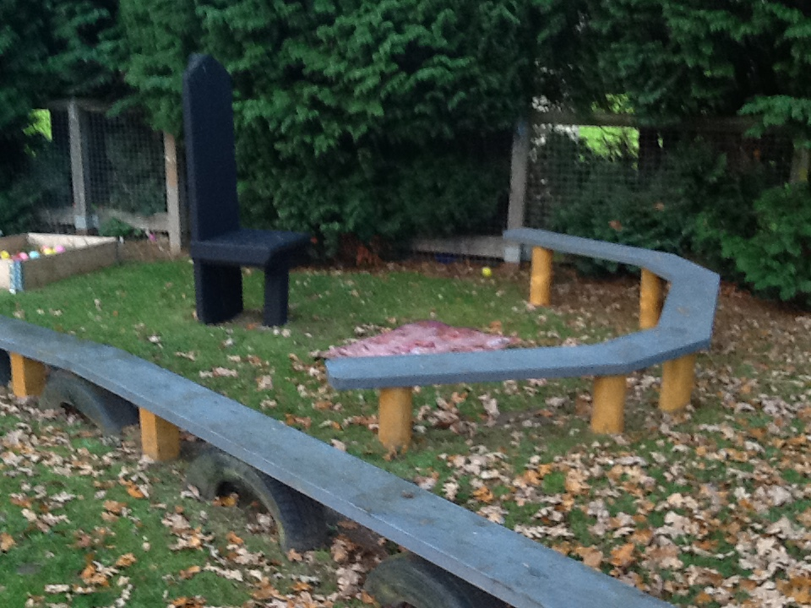
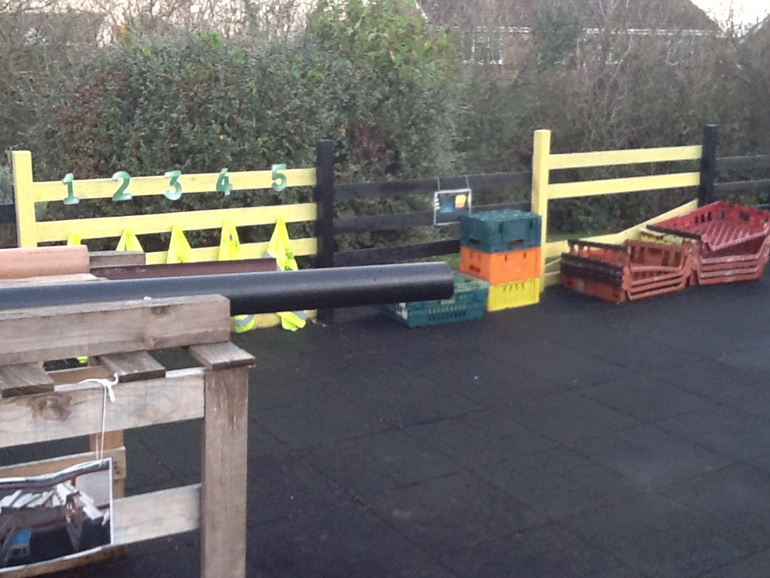
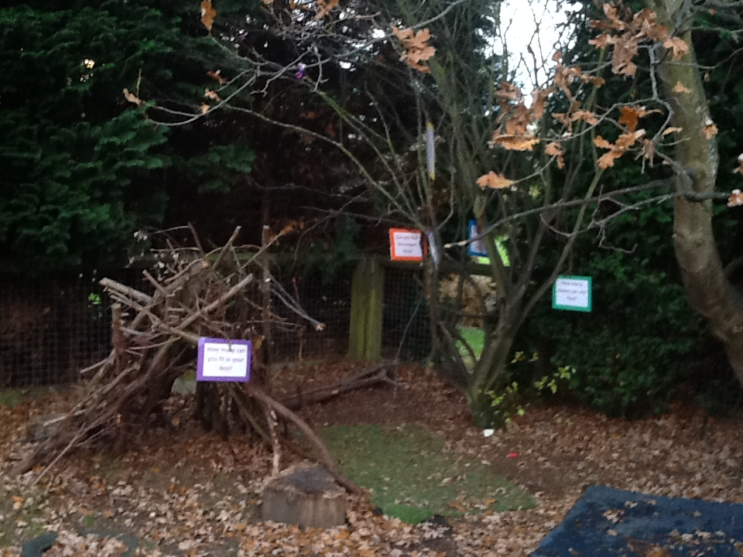
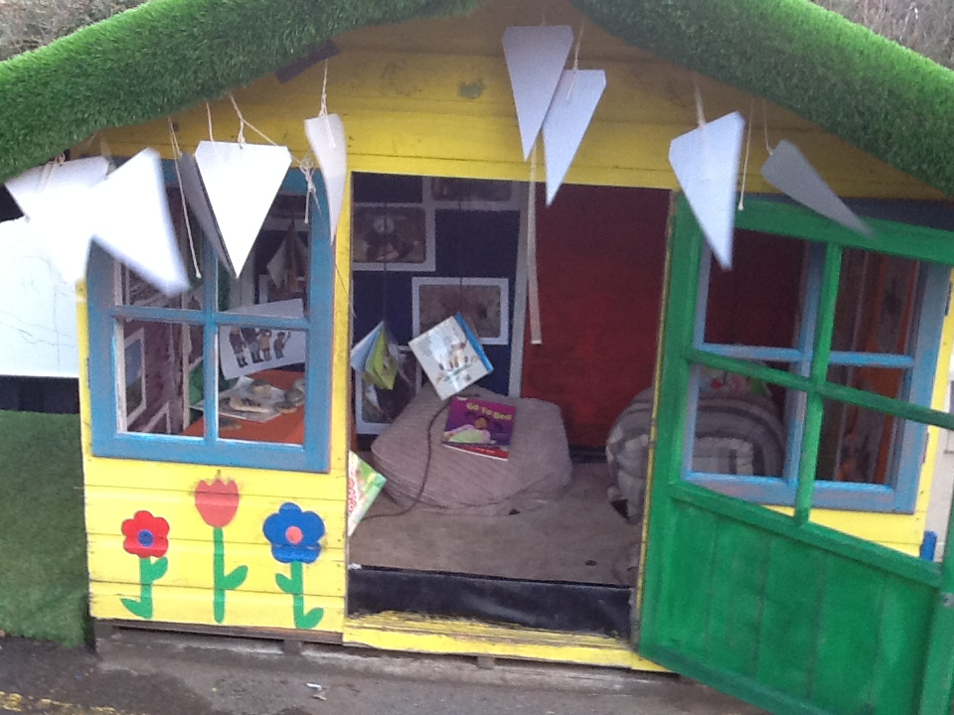
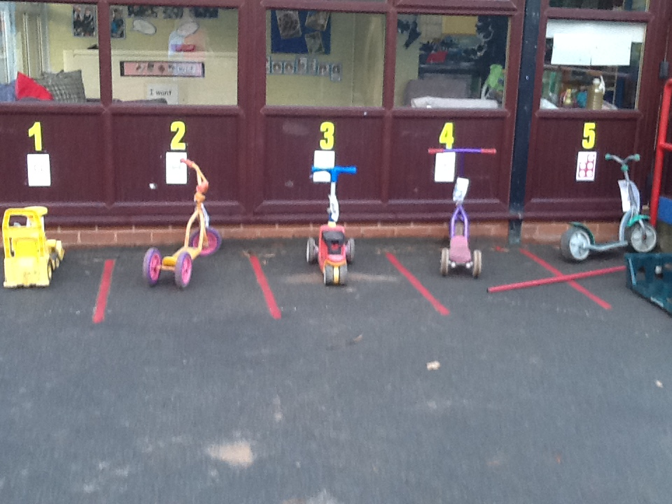
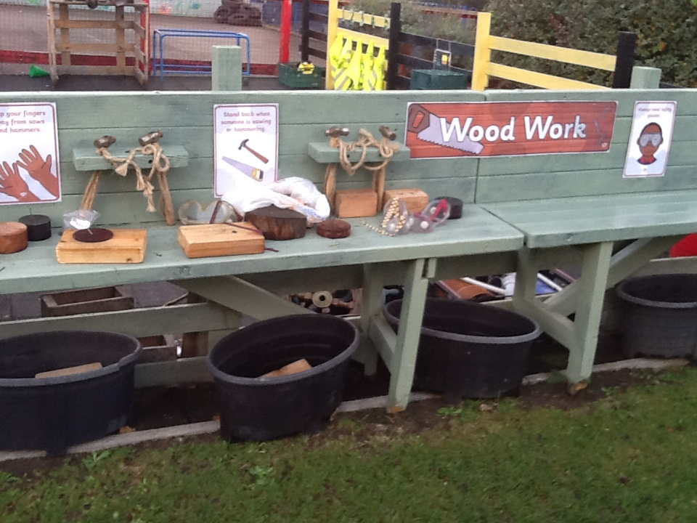
Outdoor classroom

