Slide 2
Upper Key Stage 2 Information Session
Tuesday 6th September
2022

Slide 3
Staff
Class 10 – Mrs Nicholson
Class 11 – Miss Dawson
Class 12 – Miss Hurst
Class 13 – Mrs Wallace/Miss Harrison
PE – Mr Dowson
Mrs McCabe; Mrs Whittingham;
Miss Swaddle and Mrs Trundley

Slide 4
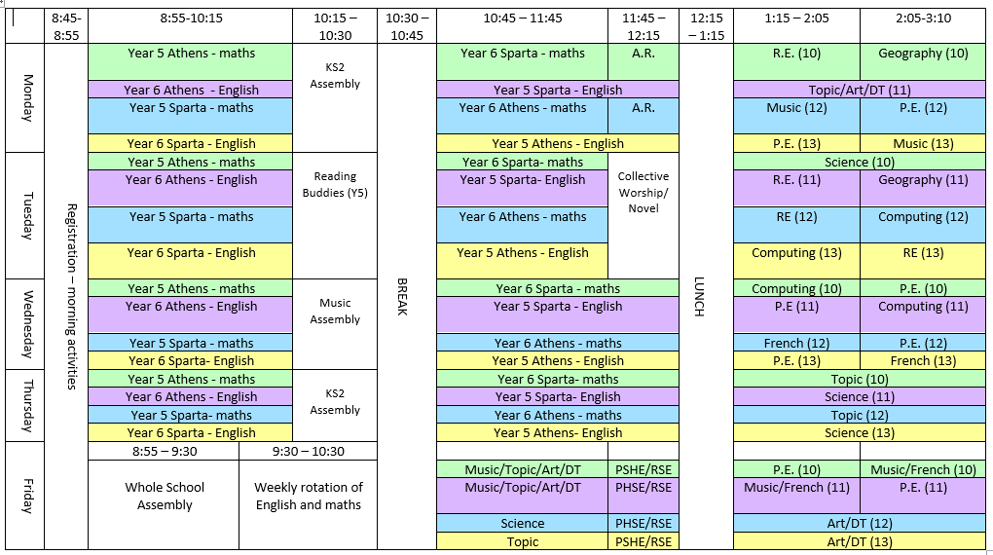
Timetable

Slide 5
Planner
*Purpose
*Information included
*How it’s used in school
*Home School Agreement
*School Challenge Award record

Slide 6
Daily routines
*Doors open 8:45am prompt
*Mobile phones
*Clubs and activities
*Jewellery/make up/hair
*Dismissal at hometime

Slide 7
Resources
*Accelerated Reader
*Times Tables Rock Stars
*Planner
*Homework

Slide 8
Homework
English (Miss Dawson and Mrs Wallace/Miss Harrison):
Weekly spellings; homework activity that could be a comprehension,
grammar based or proof-reading; and they are expected to read daily.
Miss Dawson's groups: Monday to Monday
Mrs Wallace and Miss Harrison's groups: Thursday to Thursday

Slide 9
Homework
Maths (Miss Hurst and Mrs Nicholson):
TTRS weekly (approximately 15 minutes)
Paper homework (approximately 30 minutes)
Thursday to Thursday

Slide 10
Northburn Values
Be ambitious
Be inquisitive
Be respectful
Be resilient

Slide 11
Challenge Award
Our World
Staying Healthy
Great Outdoors
Creativity
School Awards

Slide 12
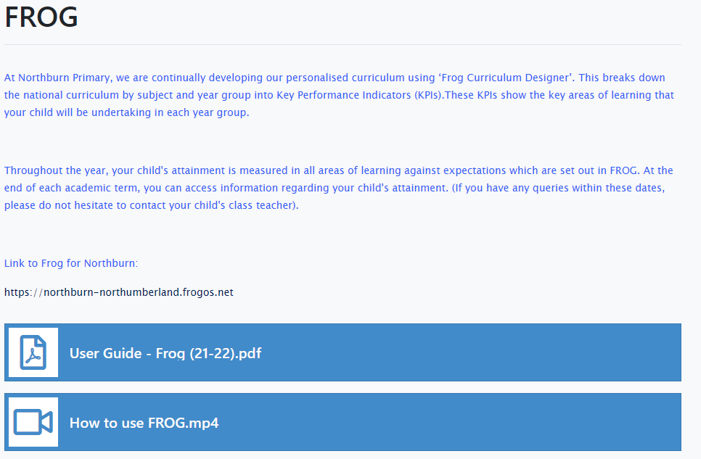
FROG
*Data released to parents three times per year

Slide 13
Zones of Regulation
http://www.northburn.northumberland.sch.uk/web/zones_of_regulation/611405

Slide 14
Communication
*Termly Key Stage newsletter
*Twitter
*Planners
*Parental permission for photos

Slide 15
Further Parent Workshops
Phonics workshop
Maths workshop
Online Safety workshop
New school website

